Slide 1
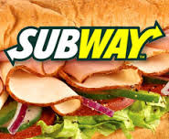
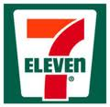
“Franchise ReSales”
A Strategic Imperative!

Slide 2
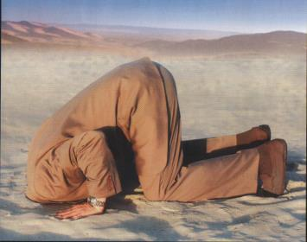
What do most Franchise Resales and time bombs have in common?
Somebody has to do something or the outcome might well be disastrous.
Nobody has ever survived one by putting their head in the sand.

Slide 3
Disclaimer….
We are not talking about the small percentage of Resales where you have a good operator, running a good business, who desires to sell his/her business for all the right reasons.
These Resale opportunities are usually bought very quickly by the Franchisors, other Franchisees, or friends or associates of the Franchisee.
Quite frankly, these hardly ever get on the open market.

Slide 4
Believe it or not, this is how many Franchisors deal with “Resales!”

Slide 5
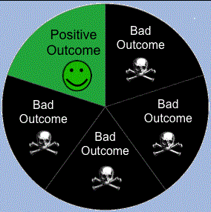
Our experience from years of brokering Franchise Resales tells us:
When a franchisor has a franchisee that is not happy with his/her own business or the franchisor has decided the time has come it would be better for the brand to replace the franchisee, there is only a 20% chance the final outcome will be a positive one.

Slide 6
There is a 20% chance your Franchisee will not be successful in his/her
efforts to sell the unit.
Feeling stuck with a business he/she cannot sell, your franchisee becomes more and more dissatisfied as time goes by. Customer satisfaction suffers, revenues and profits decrease.
When asked, this franchisee will no doubt blame you, the Franchisor, not himself for his failures.

Slide 7
There is a 20% chance you will end up taking back the franchise.
This outcome usually ends up being a financial hardship as the business will no doubt require precious financial resources to survive.
Additionally, management time will be distracted and diverted in your attempt to fix this problem unit rather than growing your Franchise.

Slide 8
There is a 20% chance your Franchisee will just close his/her business entirely and walk away.
Lost Royalties.
Negative impact on your Item 20 – A new potential Franchisee might decide not to go forward as a result of too many negative items in your Item 20.
Bad public relations. (“Dark Store”)

Slide 9
There is a 20% chance your Franchisee will sell the business to someone who would have bought
a new Franchise from you.
As a Franchisor, this scenario might solve an immediate problem with this particular Franchisee but it does not create incremental value.
If your firm uses growth to measure the progress and success of your franchise development people then this outcome is a zero sum gain.

Slide 10
A proactive approach is a strategic imperative!
KKBA has been focused almost exclusively on assisting our IFPG affiliated franchise partners with Resales since joining IFPG as an affiliated broker in September 2011.

Slide 11
A proactive approach is a strategic imperative!
Many of our IFPG affiliated Franchisors fully understand the importance of a proactive approach to resales as a strategic imperative. They “get it”!
These franchisors completely understand that even under ideal circumstances, a small percentage of franchisees don't invest the effort or have the ambition to capitalize on their territory's potential.

Slide 12
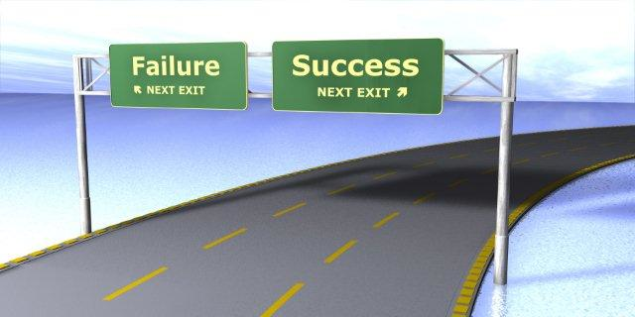
These franchisors are actively seeking to further build their brand by encouraging underperforming or disillusioned franchisees to sell and to realize success in other ways.
Why? Because It's the right thing to do for the brand and to support the future success of their franchisees.
These are the franchisors who actively work with brokers who specialize in resales like KKBA!

Slide 13
The results?
Their owners, both successful and underachieving, applaud their efforts!
They create opportunity for new owners who don’t have the financial means to start a business from scratch.
They turn a potential loss for their brand and a loss for one of their existing franchisees into a win for the brand, a win for their existing franchisee and a win for a new franchisee!

Slide 14
The results?

Slide 15
The solution…….
Selling an operating business requires a special skill set entirely different from the skill set required to sell a new franchise.
We sell the business first, then we assist the buyers in their efforts to transfer the franchise.
We have successfully sold hundreds operating businesses, (independent and franchises), and know exactly what it takes to find suitable buyers and get them to settlement.

Slide 16
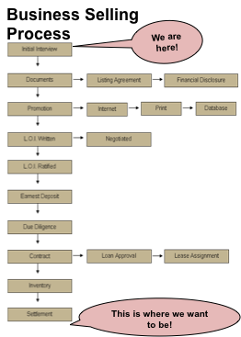
Unlike commercial real estate, residential real estate and franchise consulting, there are many obstacles along the path to settlement in a business sale transaction.
Many of the Franchisors that actually get involved in assisting their Franchisees with resales have hired in-house business sale specialists. The hard costs associated with hiring an in-house specialists can run $75,000 or more, annually!

Slide 17
Our typical buyer
In most instances is only interested in buying an existing business.
Wants a business in their specific geographic area.
Usually has prior experience or interest in the particular industry/business.
Is more interested in the historical performance of the business.
Is less afraid of buying a business that might have a few problems than they are of doing a cold start-up.

Slide 18
Our typical buyer (cont.)
Wants to know the specifics about the existing business for sale and is very resistant to being forced to endure a “franchise sales pitch” or being required to submit a comprehensive franchisee questionnaire before they can start their due diligence on the business.
Quite frequently comes to us with a reluctance to consider the franchise business model. We have to get them to change their “base of thought” to be able to convince them to even consider buying an existing business that is a franchise.

Slide 19
In conclusion…………..
Not having a proactive and effective resale plan can only harm or hurt a franchisor.
Effectively handling resales requires a unique skill set that is different from those necessary to be an effective franchise consultant.
Resale buyers are a different animal compared to those seeking to start a new franchise and as such, should be managed differently.
Handled properly, resales can turn potential loss into tremendous opportunity for all parties involved!

Slide 20
Questions? John Waller, E.V.P. Franchise Sales Group King & King / U.S. Franchise Brokers Direct: (240) 409-3033 Toll Free: (888) 565-6468 E-Mail: John@KingandKingLLC.com Website: www.KingandKingLLC.com

